Slide 1

License Plate Recognition
User Manual
Author: Muhammad Hamza Siddiqui

Slide 2
Table of Contents
Acknowledgements
About Me
About My Internship Journey with Clevered
About App
How do I use the App?

Slide 3
Acknowledgements
I would like to thank my parents first of all for believing in me and supporting me throughout this journey and for actually telling me and enrolling me for this platform. I would also like to thank my brother as he himself is practically an expert in these kinds of things and helped me if I faced any issues.
I will thank all my teachers and mentors who helped me during this journey and gave me the concept for many different topics which helped me in my code.
I will also thank all my classmates as they were helpful along the way. We helped each other for different things however we could. We had a fun time during this entire journey.

Slide 4
About Me
My name is Muhammad Hamza. I am 14 years old and I study in grade 9. I am born in Pakistan in its largest city Karachi. I am living in Saudi Arabia in its capital Riyadh. My hobbies include:
Sports such as swimming, football, basketball, tennis volleyball and badminton
Video games
Coding
Drawing and art
Reading

Slide 5
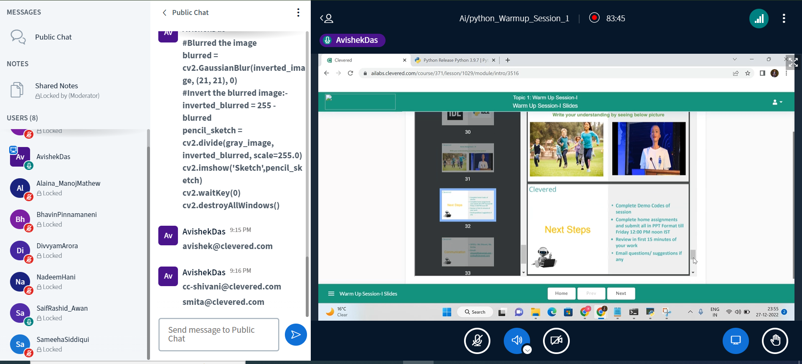
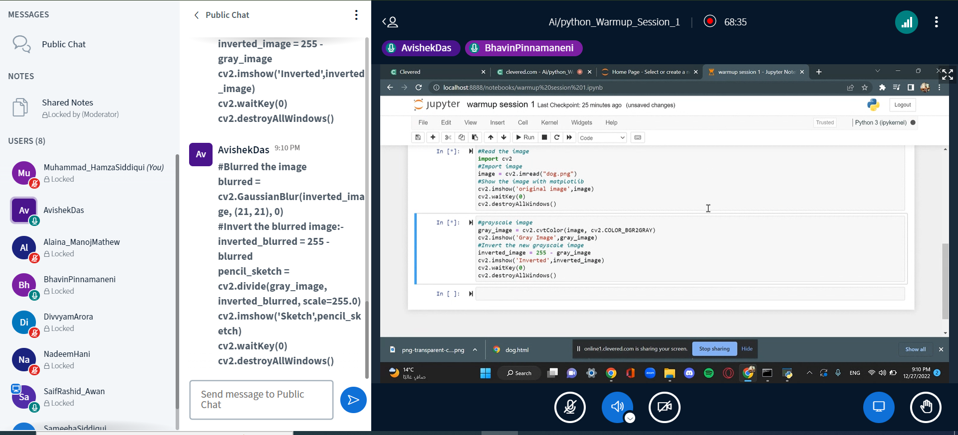
About My Internship Journey with Clevered..
My internship journey with Clevered has been really nice. I got to learn more about coding and how to execute different codes. I enhanced my skills in coding and got to learn different new concepts. It was a really nice platform for me as I was just starting my journey in AI and data. The mentors were really nice and explained everything really well and gave the concepts in a really nice way. Learning the basics of AI to being a part of this internship has been a brilliant journey.

Slide 6
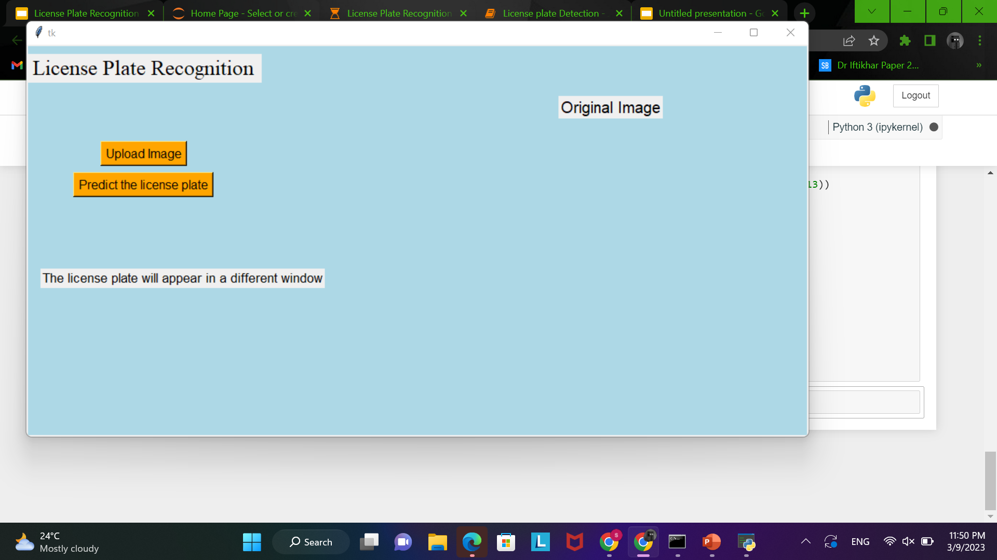
About the App
My app is about finding out the license plate of a car. It is to tell what the number plate is of a car and be able to identify which car it is so that it can be known which car is the one that is being detected
This is the main menu of the app:

Slide 7
Use of the App
The app is very useful in many aspects. It will be very helpful to be able to detect any kind of breaking in the traffic rules and regulations. It will help for better safety and security of cars as it will be able to detect any license plate. It will prove useful in stopping different issues like speeding and illegal lane changing and will be helpful for issues related to this.

Slide 8
How do I use the App?

Slide 9
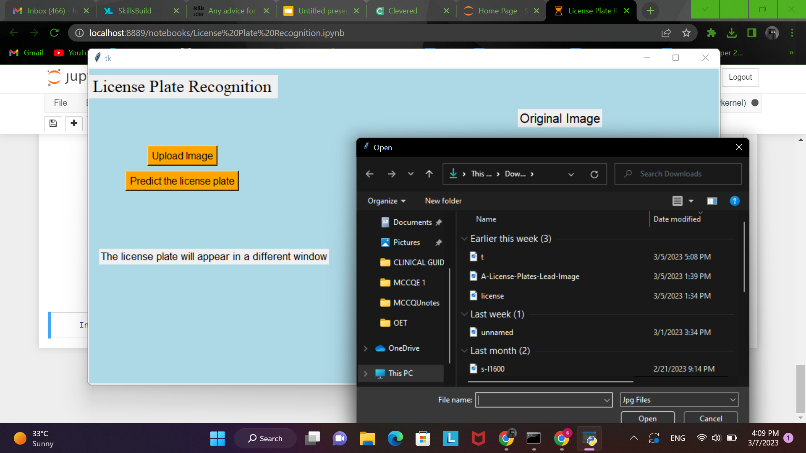
Uploading the image
Just click on the upload image button then a screen should pop up for the file explorer from which you can select the image for which you have to detect the license plate. The image should then display on your screen on the right-hand side.

Slide 10
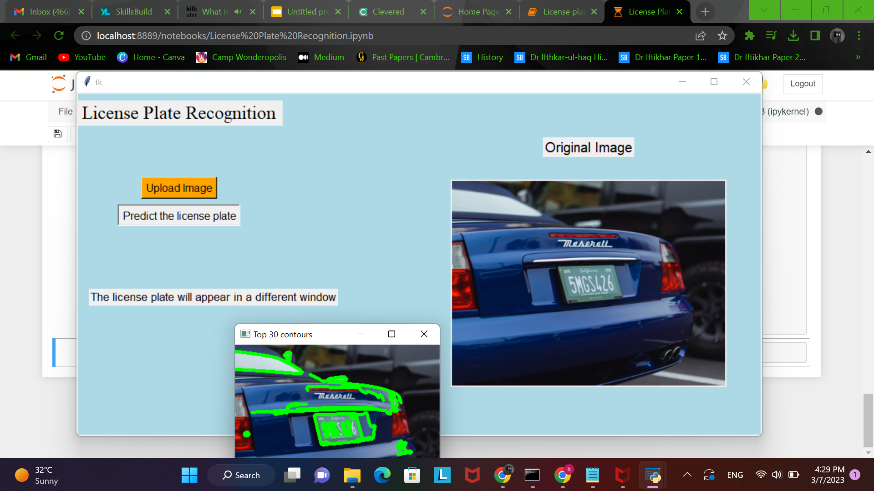
Detecting the License Plate
For detecting click the “predict license plate button” which is located right below the upload image button. Then the image should start checking the image and it will display a cropped image of the license plate of the car in a smoother way so it is visible. This will appear in a new window.
The only problem you will face is that while detecting the image it has to calibrate it so different windows pop up of it calibrating so you will have to close them.

Slide 11
Contact Person
If you have any issues or suggestion then please contact me at:
hamza.theghostrider@gmail.com

Slide 12
Social Media Accounts
Github:
Muhammad-Hamza-Siddiqui
Linkedin:
Hamza Siddiqui

Slide 13
THANK YOU!!!

